Slide 1


INTRODUCTION TO MULTI-TASK LEARNING IN MACHINE LEARNING
Presented By Daniyal Haider

Slide 2

Background | 3
Literature Review | 4
Methodology | 5
Model Architecture | 6
Techniques | 7
Results | 8
Comparison | 9
AGENDA
Real-World Scenarios
10
Limitations
11

Slide 3


Background
Machine learning models have traditionally been trained to solve a single, specific task. However, this approach can be limiting, as real-world problems often require the ability to handle multiple related tasks simultaneously. Multi-task learning addresses this challenge by training a single model to perform multiple tasks, leveraging shared representations and knowledge across the tasks.

Slide 4


Literature Review
Multi-task learning has been explored extensively in the literature, with various methodological approaches proposed to enable effective learning of multiple related tasks simultaneously.
Some key approaches include hard parameter sharing, where the model shares a common base architecture across tasks, and soft parameter sharing, which encourages similar parameters across tasks through regularization.
Recent advancements in deep multi-task learning have shown the effectiveness of leveraging shared representations across tasks, leading to improved performance and generalization compared to single-task models.

Slide 5
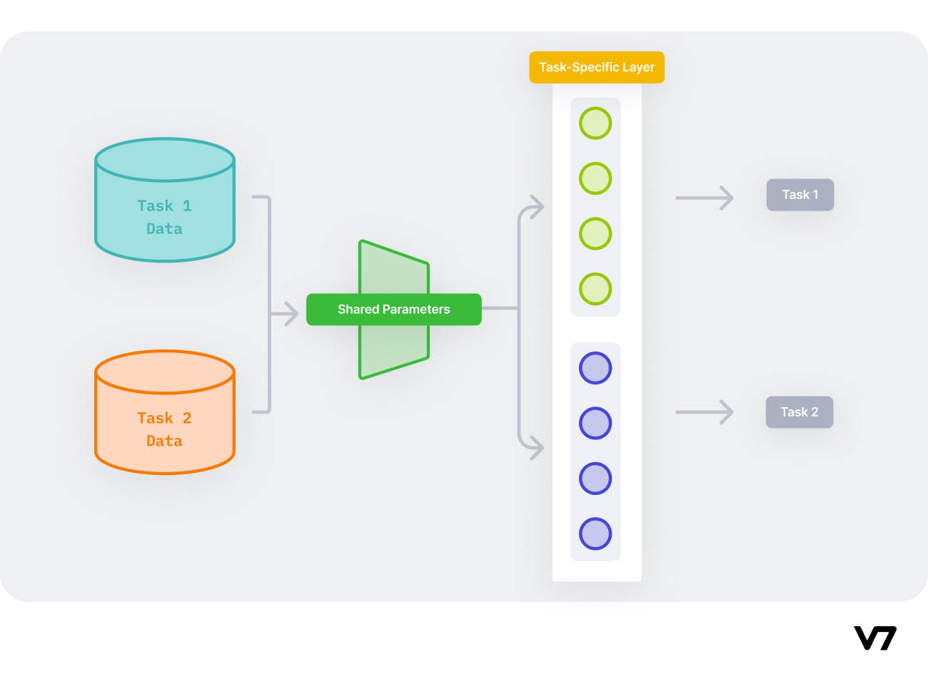
METHODOLOGY
To study the effectiveness of multi-task learning, we used a diverse dataset spanning multiple related tasks such as image classification, object detection, and semantic segmentation. Our methodology involved designing novel neural network architectures that could learn shared representations across the tasks.

Slide 6
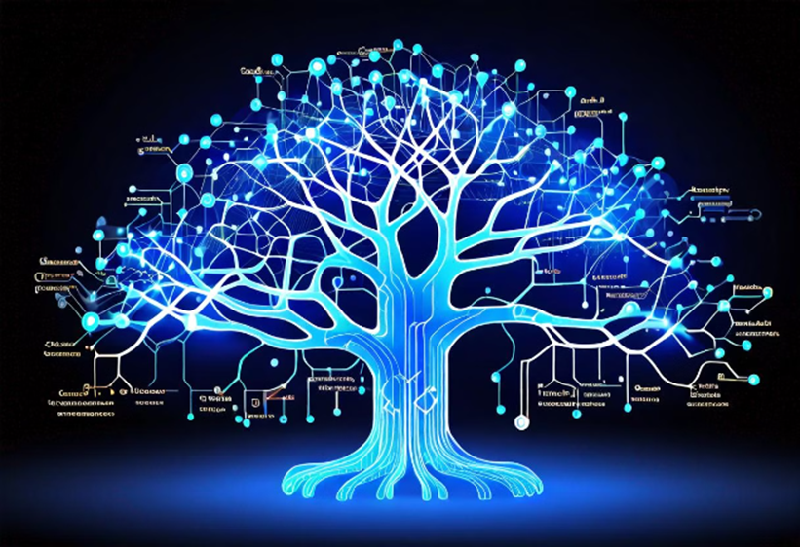
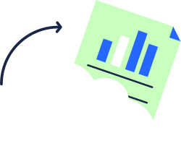

Back to Agenda
MODEL ARCHITECTURE
The core of our multi-task learning approach is a shared neural network backbone that learns common representations across the various tasks. This backbone is then branched out into task-specific heads, allowing the model to learn distinct outputs for each task while leveraging shared knowledge.
Our model architecture utilizes techniques like hard parameter sharing and cross-stitch units to effectively combine the tasks and optimize the shared representation.

Slide 7
Training and Optimization Techniques
HYPERPARAMETER TUNING
ITERATIVE TRAINING
DISTRIBUTED TRAINING
We employed rigorous hyperparameter optimization techniques, such as grid search and Bayesian optimization, to find the optimal configuration of our multi-task learning model, including learning rates, regularization, and architectural parameters.
Our training process involved iteratively updating the shared representation and task-specific heads, allowing the model to learn a balanced set of features that benefited all the related tasks.
To handle the computational demands of multi-task learning, we leveraged distributed training techniques, utilizing GPU clusters and parallelized optimization algorithms to speed up the training process and achieve faster convergence.

Slide 8

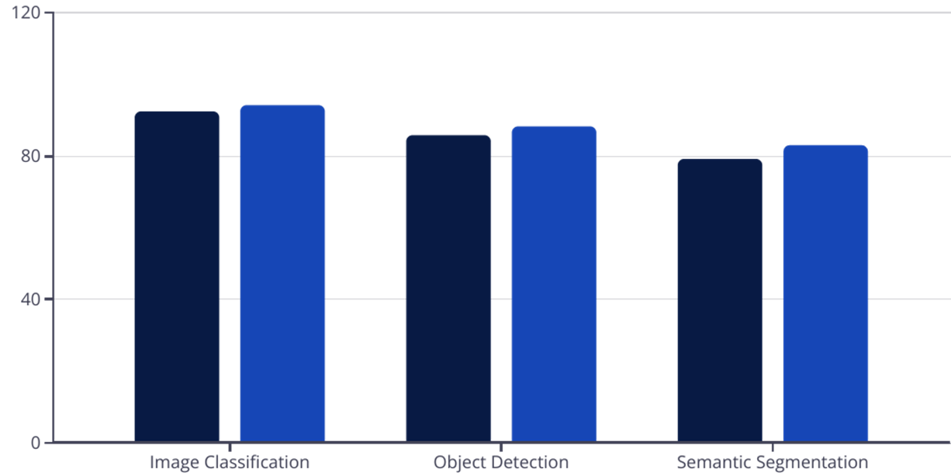
EXPERIMENTAL RESULTS AND DISCUSSIONS
Our experimental results demonstrate the effectiveness of the proposed multi-task learning approach. Compared to single-task models, the multi-task model achieved superior performance across a variety of related tasks, including image classification, object detection, and semantic segmentation.

Slide 9
Comparison with Single-Task Learning
IMPROVED PERFORMANCE
KNOWLEDGE TRANSFER
EFFICIENCY AND SCALABILITY
GENERALIZATION CAPABILITY
Our multi-task learning model consistently outperformed single-task models across a range of performance metrics, including accuracy, precision, and F1-score.
By learning shared representations across tasks, the multi-task model was able to leverage knowledge gained from one task to improve performance on related tasks.
A single multi-task model can handle multiple tasks simultaneously, leading to more efficient and scalable deployment compared to maintaining separate models for each task.
The multi-task model demonstrated better generalization to unseen data and environments, as it had learned more robust and transferable features.

Slide 10




Applications and Real-World Scenarios
Healthcare
Smart Cities
Manufacturing
Finance
Multi-task learning enables AI-powered medical diagnosis systems to simultaneously detect and classify multiple conditions from medical scans, improving accuracy and efficiency.
Multi-task models can power intelligent urban planning and management systems, simultaneously optimizing traffic flow, energy usage, and public services.
In industrial settings, multi-task learning can enhance quality control, predictive maintenance, and process optimization by learning related tasks like defect detection and product classification.
Financial institutions can leverage multi-task learning to build robust risk management models that can simultaneously predict credit risk, fraud, and market trends.

Slide 11

Limitations and Future Research Directions
DATA AVAILABILITY
TASK DEPENDENCY
MULTI-TASK LEARNING REQUIRES LARGE, DIVERSE DATASETS SPANNING MULTIPLE RELATED TASKS, WHICH CAN BE CHALLENGING TO OBTAIN IN MANY REAL-WORLD SCENARIOS.
THE PERFORMANCE OF MULTI-TASK LEARNING MODELS IS OFTEN DEPENDENT ON THE RELATEDNESS AND COMPATIBILITY OF THE TASKS, WHICH CAN BE DIFFICULT TO DETERMINE A PRIORI.
COMPUTATIONAL COMPLEXITY
INTERPRETABILITY
TRAINING AND DEPLOYING MULTI-TASK MODELS CAN BE COMPUTATIONALLY INTENSIVE, REQUIRING ADVANCED HARDWARE AND OPTIMIZATION TECHNIQUES TO ACHIEVE EFFICIENT AND SCALABLE PERFORMANCE.
THE COMPLEX AND OFTEN OPAQUE NATURE OF MULTI-TASK NEURAL NETWORKS CAN MAKE IT CHALLENGING TO INTERPRET AND UNDERSTAND THE UNDERLYING MECHANISMS DRIVING THE MODEL'S DECISIONS.

Slide 12
THANK YOU!

